Slide 1
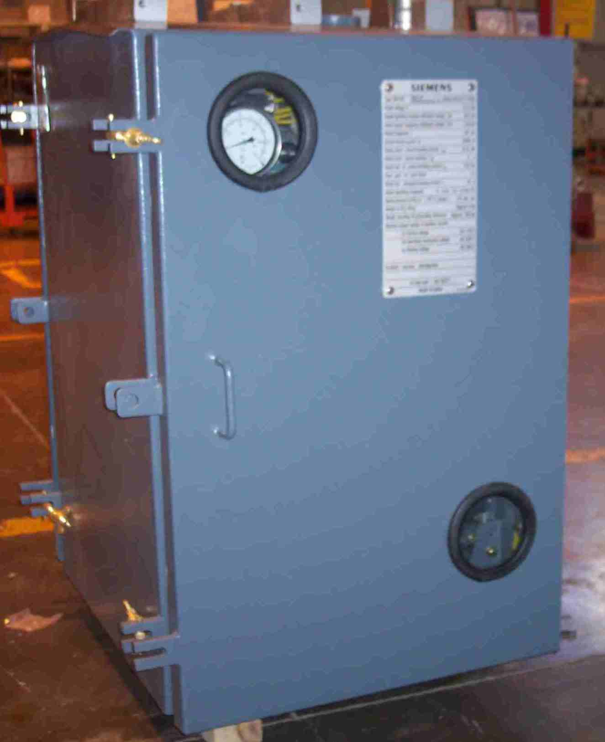
SIEMENS
HVCB SPARES
Drive Mechanism with Panel
72.5KV, 31.5KA CB
S4713650011

